Slide 1
Special Education Budget Presentation
FY 2025
Dan Alexander, Director of Special Education

Slide 2
Disability Categories
ABI – Acquired Brain Injury -1 MD – Multiple Disabilities-17
AUT – Autism-256 OHI – Other Health Impaired-256
DD – Developmental Delay-514 ORT – Orthopedic Impairment-1
DF – Deafness-6 SLD – Specific Learning Disability-717
ED – Emotional Disturbance-134 SLI – Speech/Language Impairment-120
HI – Hearing Impairment-2 TBI – Traumatic Brain Injury-4
ID – Intellectual Disability-76 VI – Visually Impaired-10
Total Number of SpEd Students Pre-K-12= 2114

Slide 3
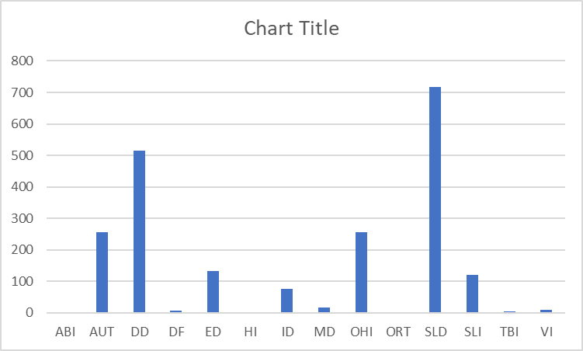
Our Students

Slide 4
The Special Education Process
Referral Received – District has 15 business days to meet with the parent(s) to determine suspected area(s) of disability
Permission to Evaluate – District has 60 calendar days to evaluate and meet with parent(s) to review results
Student found Eligible – District has 30 calendar days to develop an IEP and meet with parent(s) to review
IEP agreed upon – District must propose placement (determined based on Least Restrictive Environment)
School vacations, world-wide health pandemics, weather cancellations, etc. do not interrupt the timelines

Slide 5
Special Education Budget Requests for FY 25
Middle School Special Ed Coordinator
Two (2) Full-Time American Sign Language Interpreters
Brentwood Coordinator

Slide 6
Rationale for Middle School Special Ed Coordinator
Nashua district-wide SpEd programs (~100 students with significant needs) will be centralized at McCarthy Middle School
Onsite support three (3) days per week and one (1) day each to the other two middle schools
Continuity across all of the middle schools for SpEd programing and instruction
Support transitions for SpEd students into Middle School as well as from Middle School to High School
Positive Outcomes observed from Newly Hired Elementary Coordinators :
Improved relationships between the SpEd department and school administrations
Coordinators are present in the buildings and accessible to provide direct support to both administrators and teachers
Active members of the schools’ SpEd teams which has fostered an environment of trust, support and improved/timely communication

Slide 7
Rationale for 2 Full-Time ASL Interpreter s
The District’s Signs of Learning Program continues to grow PreK - Grade 12+
The District currently accepts students from ten (10) other SAUs into the program
Due to the growth of the program and the number of students requiring interpreting, the District is in need of an additional interpreter
The position will be charged to the Special Revenue Fund and will be covered by the cost of tuition from other Districts

Slide 8
Rationale for Brentwood Certified Coordinator
Franklin Street School houses two of the most intensive populations in the school district.
Brentwood Academy: The Brentwood Academy population has almost doubled in size from 15 to 28 students (currently)
To continue to grow and maintain a therapeutic learning environment for students with emotional challenges, a full-time administrator dedicated to Brentwood is crucial to the operation and cultivation of the culture. The goal is to maintain a population of 30-35 students with ~30% from school districts outside of Nashua. The addition of a Brentwood Coordinator would allow this to occur.
Franklin Street Preschool: The total student population of Franklin Street School has doubled from approximately 150 students (2022-23) to 310 students (2023-34)
Franklin Street is the student/family's first exposure to the Nashua School District. With the appropriate administrative team, we will lay the foundation for their child’s entire experience in the Nashua School District.
The position will be charged to the Special Revenue Fund and will be covered by the cost of tuition from other districts.

